Slide 1

“Approximate” Multiplicative Relationships between Quantitative Unknowns
Amy Hackenberg
Robin Jones
Ayfer Eker
Mark Creager
Ryan Timmons
Indiana University-Bloomington
This presentation is based upon work supported by the National Science Foundation under Grant No. DRL-1252575
Notes:
Mark
Thank you for coming to our presentation, approximate multiplicative relationships between quantitative unknowns.

Slide 2
Rationale
Students continue to struggle to learn algebraic ways of thinking and to pass algebra courses (e.g., Helfand, 2006; Stein, Kaufman, Sherman, & Hillen, 2011);
Much is still not known about how students use algebraic notation to represent relationships between quantitative unknowns (Kieren, 2007);
More information about how students learn algebra (e.g., learning trajectories) is needed to inform standards development, such as the Common Core.
Notes:
Mark
We know from research that students struggle to learn algebraic ways of thinking and pass algebra, and that much is unknown about how students use algebraic notation to represent quantitative unknowns a term we describe later.

Slide 3
Purpose of paper
Describe and account for how some middle school students viewed multiplicative relationships between quantitative unknowns as tenuous or, in the words of one student Tim₇, “approximate.”
Notes:
Mark
Toward this end, we are working on a project about how to differentiate instruction for cognitively diverse middle school students. As part of that project, we conducted an 18-episode design experiment. One purpose of the experiment was to investigate relationships between students’ rational number knowledge and algebraic reasoning, including how students write equations to express multiplicative relationships between quantitative unknowns. The purpose of this paper is…

Slide 4
Algebra from a Quantitative Perspective
Unknowns are potential measurements of quantities.
Thinking of a quantitative unknown—say a distance— requires being able to imagine a unit of units.
Notes:
In the project we take a quantitative perspective, which means that unknowns are quantities for which a value is not currently known, but for which a value could be determined. So, this bar could represent a known quantity where 11 units is the value of this length.
The second bar is an unknown quantity because the value is not known, but we can imagine the quantity (in this case, a length) as subdivided into units that we could enumerate.
Through this approach we have identified that thinking of a quantitative unknown requires being able to take a unit of units as a given, but not all students can do that.

Slide 5
Second Multiplicative Concept (MC2 students)
Can anticipate the coordination of two levels of units prior to operating
Can produce three levels of units in activity
Notes:
Mark
This paper focuses on students who can take a unit of units as given. We call these students, students operating with the second multiplicative concept (MC2 students). These students have the potential to treat a length as a unit containing some number of equal units, and they can do so prior to operating in a situation. For example, everyone in here can imagine a foot-long length, and you can imagine marking it into equal parts—say 5 of them. This is something MC2 students can do as well.
In activity MC2 students can make three levels of units. For example, they can insert seven parts into each of the five parts in the 5/5-foot and determine that they have made 35 parts in all. However, once they do so, the 35/35-foot is not likely to retain its structure as unit of five units each containing seven units.

Slide 6
Method
  18-episode design experiment conducted after school with 9 middle school (7th and 8th grade) students;
  6 were MC2 students; 5 of these regularly attended
  1-hr episodes twice per week for 9 weeks
  Selection process: interview and written worksheet with 21 students to assess multiplicative concepts, fractional knowledge
  During the episodes:
  Flow of whole class discussion/activity and small group work
  One researcher was the teacher; other researchers assisted by running roaming cameras, interacting with students, taking notes
  Data collection included:
  Video recording all episodes with 3 cameras (mixed into 1 file for analysis)
  Screenflow recordings of students’ work in small groups on laptops; students used JavaBars and Geometer’s Sketchpad
  Data analysis: Underway!
  Student portraits
Notes:
Ayfer: We conducted an 18-episode design experiment (?in the fall of 2013?) with 9 students. 6 of them were MC2 students and 5 of them attended regularly. In order to select students, a total of 21 students were interviewed to assess their multiplicative concepts and fractional knowledge. We recorded the episodes by 3 cameras then mixed them into 1 file. Students’ group work on JavaBars and Geometer’s Sketchpad was recorded by Screenflow software program. We started to create student portraits and we are currently in the process of analyzing.
Ayfer comment: It is a lot so I tried to summarize thinking they will have access to our paper anyways.

Slide 7
Corn Stalk Tomato Plant Heights Problem
There is a tomato plant and stalk of corn growing in the garden, each of unknown height. The height of the stalk of corn is 5 times the height of the tomato plant.
  Draw a picture of this situation and describe what your picture represents.
  Write an equation for this situation that relates the two heights. Explain what your equation means in terms of your picture.
  Can you write another, different equation that relates the two heights? Explain what your equation means in terms of your picture.
  If you wrote an equation using division, can you write it with multiplication? Explain what your new equation means in terms of your picture.
  Let’s say that the stalk of corn’s height is 150 cm. How tall is the tomato plant?
  Use this example to check all of your equations.
  If an equation does not work, see if you can change it so that it does.
Notes:
Ayfer: This is an example of the tasks we used in the experiments. It’s about multiplicative relationships between two unknowns; height of a corn stalk is 5 times the height of a tomato plant. Students worked on this problem in their groups and then we had whole class discussion about their products.

Slide 8
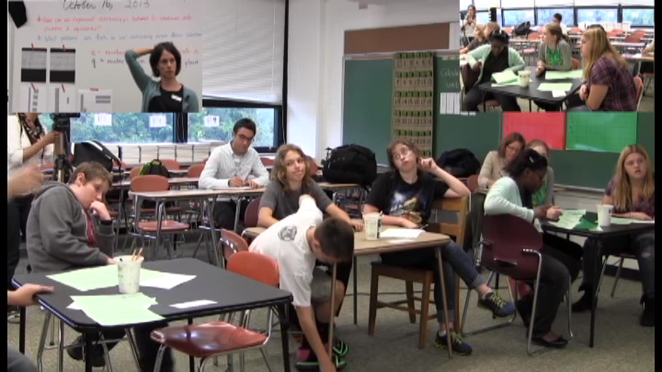
Tim’s view
Notes:
Ayfer: Here is a short video clip of whole class discussion about the problem you just saw. This is our classroom setting, students sitting in their groups and the teacher is guiding the discussion about their work from previous episode. During the sharing out as a whole class, one of the MC2 students, Tim, talked about the multiplicative relationship between unknowns being approximate. You cannot see but he is right here (point to screen).
[play the clip]
Later in the discussion he says, “But as for this [holding up the worksheet], you don’t know the corn stalk height, you don’t know the tomato plant height. So you don’t know anything.”
This was an important moment for us because Tim stated unknown quantities can’t have known, permanent relationships. If the heights of the tomato plant and corn stalk aren’t known, then any relationship between them is approximate. Our analysis showed that this was not a momentary comment, Tim held to that idea during the whole experiment, including his follow-up interview.

Slide 9
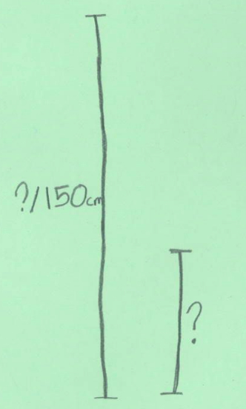
Other Students’ Work
Notes:
Robin – BE BRIEF IN 9 & 10!!
Though Tim was the only one to consistently use the term ‘approximate,’ others gave indications that the relationship wasn’t precise to them. The clearest example of this can be seen in students’ initial drawings to show the two heights in the corn stalk – tomato plant problem. Three different MC2 students produced unmarked segments like this to represent the relationship between the cornstalk and tomato plant heights. This [left] is from Andrea, and this [right] is from Paige.

Slide 10
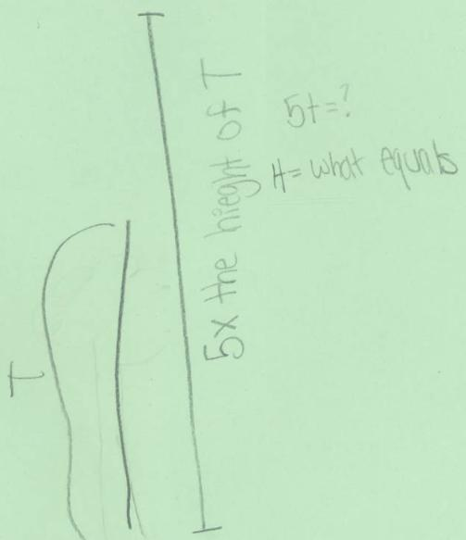
Other Students’ Work
Notes:
Robin
This drawing came from Lucy, another MC2 student.
We take these drawings, and similar ones done by MC2 students for a variety of problems involving unknown heights, as clues to the mathematical structures these students are creating. Specifically, we wonder if it was the unknownness of the quantities that made it difficult for MC2 students to show precise relationships in drawings. When given a numerical example for the cornstalk-tomato plant problem, many of them were able to draw pictures showing a 5x relationship, with the cs marked into 5 sections, 1 of which was the height of the tomato plant.

Slide 11
Accounting for “Approximate”
Need to simplify units coordinations involved in these problems.
Notes:
Robin
Our main account for MC2 students’ ideas that multiplicative relationships between unknowns were tentative or tenuous is that the students needed to simplify the units coordinations involved in these problems. We’ll sketch this account for Tim_{7,},
As an MC2 student, Tim₇ could coordinate two levels of units prior to activity, so he could think about a quantitative unknown, x, [point to it] as a unit of units, although the number of units within the unit was unspecified. In addition, Tim₇ could coordinate three levels of units in activity, so he could take the quantitative unknown [x, this whole chunk – point to x] 5 times to make 5x as a unit of units of units in activity. BUT…

Slide 12
Accounting for “Approximate”
Notes:
Robin
However, in further operating Tim₇ would not maintain the quantity represented by 5x as a three-levels-of-units structure because MC2 students do not maintain and further operate with three-levels-of-units structures. With a known product like 5 x 7, Tim₇ could make an evaluation (5 x 7 = 35), so that he could continue to work with the result of 5 x 7 as unit of 35 units. In contrast, with 5x Tim₇ would not be able to make an evaluation in order to view 5x as only a unit of units [i.e. to reduce the number of levels of units he’s trying to coordinate].
So, let’s say that Tim₇ aimed to maintain 5x as a quantitative unknown. If Tim₇ tried to use 5x as a quantitative unknown in further operating, it would likely become an unknown without the five units (of units), because Tim₇ could not maintain the three-levels-of-units structure in further activity. Thus we suggest that the unknown would become somewhat “undifferentiated” as Tim₇ worked further with it. This account could lead to Tim₇’s idea that multiplicative relationships were “approximate.” It also could be an important root for the MC2 students’ need for numerical examples, or considerable teacher support, in order to structure multiplicative relationships between unknowns.

Slide 13
Some Questions…
How would you describe the relationship between unknowns for Tim? We are debating what terms best capture it.
In our presentation we have not covered other reasons that students might view the relationship between unknowns as approximate (although we do discuss this in our paper). What are other reasons that you think of in trying to account for Tim?
We responded to Tim’s idea of “approximate” with a change in how we approached work on quantitative unknowns in a second experiment. What changes would you suggest based on what you have seen here?
Notes:
Robin
[I’ve just made these up… I don’t know if they are the best ones to ask… I do think #1 would be helpful especially, but it would be more helpful if people had read the paper.]

Slide 14
Thank you!
For references, please see our paper.
IDReAM project website: http://www.indiana.edu/~idream
Amy: ahackenb@indiana.edu
Robin: robijone@indiana.edu
Ayfer: ayeker@indiana.edu
Mark: macreage@indiana.edu
Ryan: rtimmons@indiana.edu

